Slide 1
ORJENA
MAX MATTE LIPSTICK

Slide 2
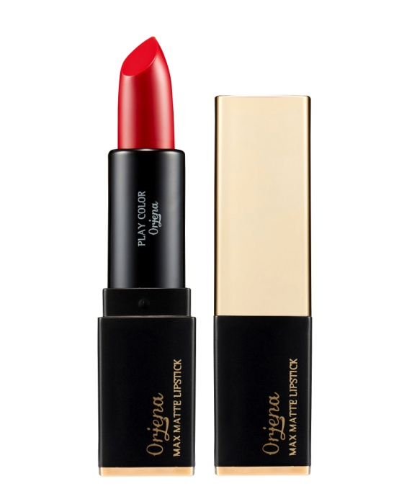
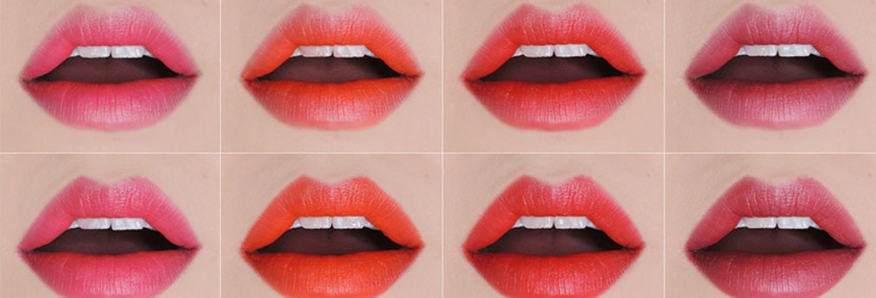
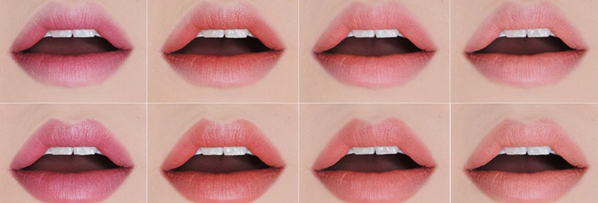










ORJENA MAX MATTE LIPSTICK
Matte type, rich and high pigment lip stick with vivid color.
Long-lasting, light texture for light fitting and real high color express.
No.1 : Romantic Red
No.2 : Miracle Pink
No.3 : Sweet Heart
No.4 : Pink Soda
No.5 : Pink Holler
No.6 : French Coral
No.7 : Love Me
No.8 : For You
No.9 : Grace Rose
No.10 : Velvet Beige
Net weight: 3.5g
Manufacturer : Anne co., ltd.
Brand seller : Wannabe cosmetic co., ltd.
RSP : KRW12,000/pc

Slide 3
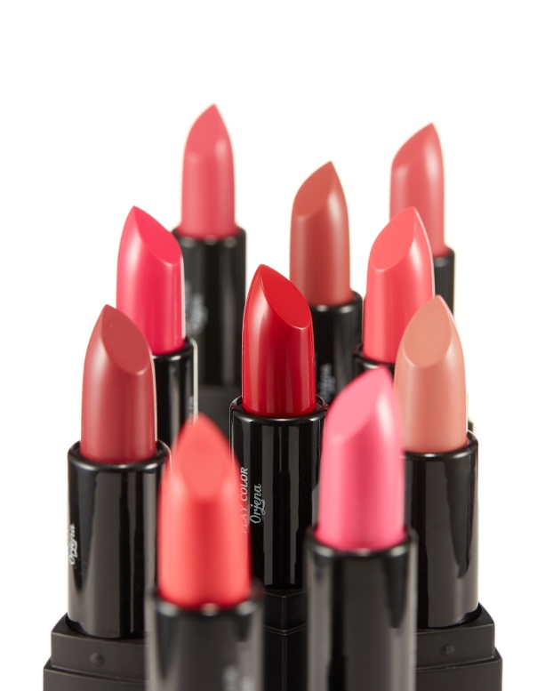
First
COLOR EXPRESSION: PHOTO-SHOP COLOR
Color expression as your imagine!!
Micro pigment
makes a perfect color expression
Second
REAL MATTE FINISH
Soft and light matte formula
Provide a chic color finish
Third
SUPER SILKY TEXTURE
Special powder capsule provide
long wearing and light silky texture
No people to buy 1 time

Slide 4
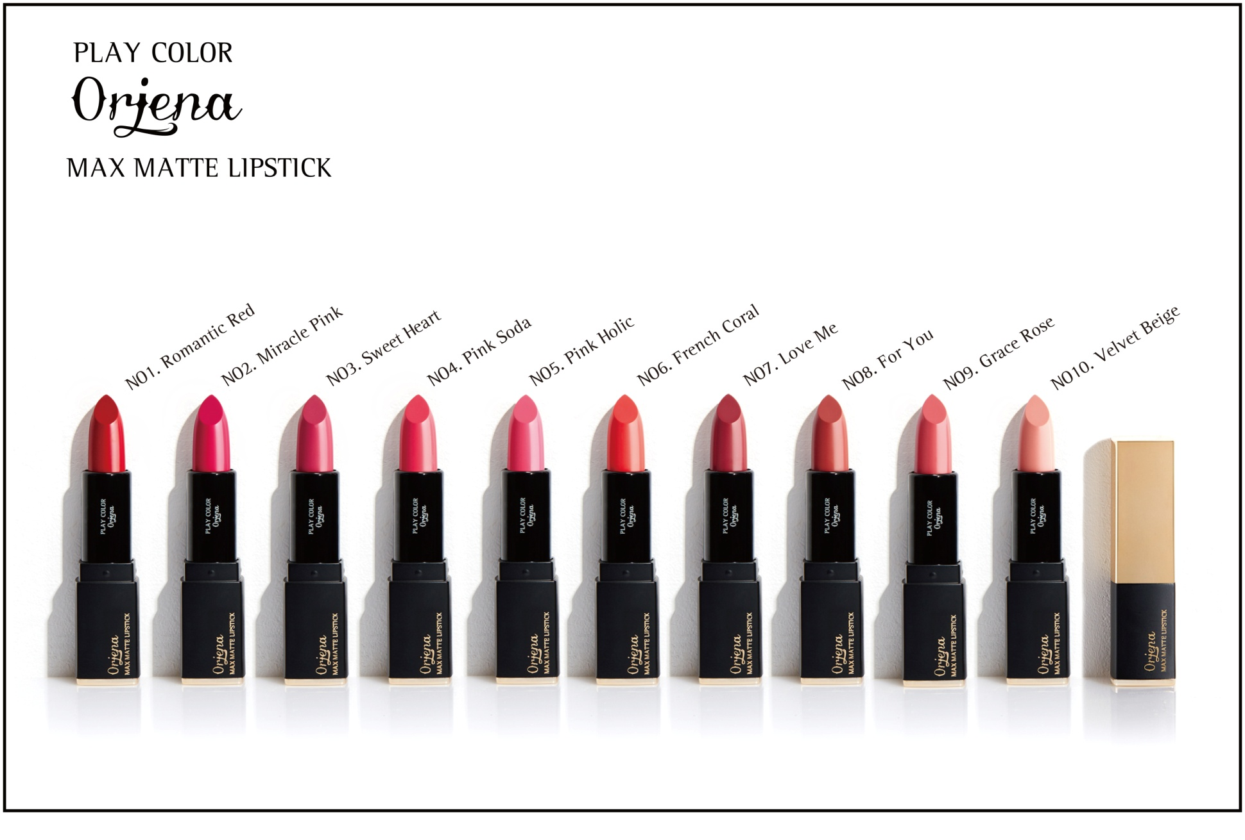

Slide 5
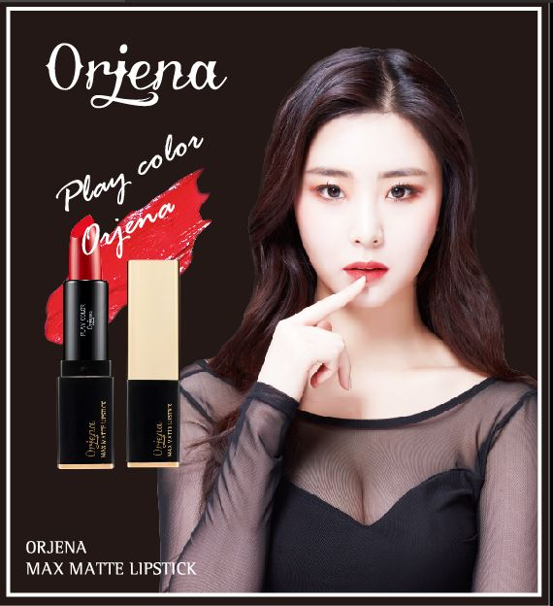
THANK-YOU

